Slide 1
The Seven Churches of Revelation:
“Sardis – Asleep in the Light”
Part of a study of the Book of Revelation chapters 2 & 3 in which Jesus writes to the Seven Churches in the Province of Asia (now Western Turkey).
By Andy Acreman, Thurrock Christian Fellowship
16th June 2024

Slide 2
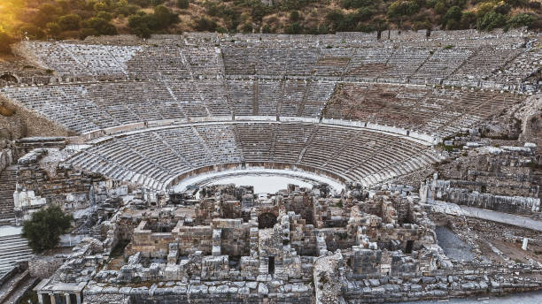
Points to Cover…
Summary of the Three Churches already covered
Sardis - the city: its geography, history, and culture
What does Jesus know about the church?
What does Jesus commend and criticise?
What promises and warnings does He give them?
How does all this apply to us in TCF today? (Throughout)

Slide 3
Summary of the Three Churches Covered…
Ephesus: Doing well in many ways, but having lost its first love – so missing the point! All Martha; no Mary.
Smyrna: Suffering under intense persecution but passing the test with flying colours! Well done!
Pergamum: Suffering under intense persecution and most remaining faithful – but some were falling to false teaching and sexual immorality.

Slide 4
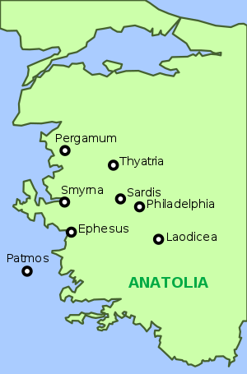
Geography of the Seven Churches…
Ephesus (now a monument)
Smyrna (now Izmir)
Pergamum (no longer exists)
Thyatira (now Akhisar)
Sardis (no longer exists)
Philadelphia (now Alasehir)
Laodicea (now Denizli)
See also Island of Patmos

Slide 5
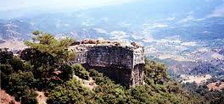
The Ancient City of Sardis…
Notes:
This city – the capital of ancient Lydia - was built even higher than Pergamum: it was built on a mountain peak where three side were vertical smooth rock walls. It rose 1,500 feet about its surrounding valley and was therefore a natural fortress. Only the South side was ever actually guarded. The Siege of Sardis in 547 BC by King Cyrus of Persia was a key battle in the history of the Persian empire against the Lydian empire’s forces.
The Greek historian Herodotus tells the story of the fall of Sardis in days of Cyrus the Persian emperor. King Cyrus came to Sardis and found the position of the city ideally suited for defence. There seemed to be no way to scale the steep cliff walls surrounding the city. He offered a rich reward to any soldier in his army who could figure out a way to get up to the city. One solider studied the problem carefully, and as he looked, he saw a soldier defending Sardis drop his helmet down the cliff walls. He watched as the soldier climbed down a hidden trail to recover his helmet. He marked the location of the trail and led a detachment of troops up it that night. They easily climbed the cliffs, came to the actual city walls and found them unguarded. The soldiers of Sardis were so confident in the natural defences of their city they felt no need to keep a diligent watch, so the city was easily conquered.
It was captured again in similar fashion in 214 BC, by the Antiochus III and later inherited by the Romans. Despite being known as ‘the strongest place in the world’! They hadn’t learned their lesson!
As a city it had always been very wealthy and famous. It was the first place in the world where gold and silver coins were minted. Croesus, the last king of Lydia had vast wealth and was the richest man of his time. It had the Temple of Artemis, the fourth largest in the world.
So, this ancient city had already seen better days. It was still very wealthy and known for its softness and luxury. Easy money was available at Sardis. Morals were lax and the city became a byword for decadence and pleasure.
Most of the impressive Roman-era remains now visible at Sardis were constructed after the tragic earthquake at night in 17 AD. The emperor Tiberius helped sponsor reconstruction efforts, earning greater local renown for himself. In John’s day the civic structures included a theatre, a stadium, a central marble road, and multiple temples.
Local Jews later secured some of the most valued land in the city to build one of the largest synagogues in Asia Minor, roughly the length of a football field.

Slide 6
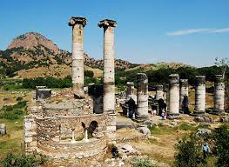
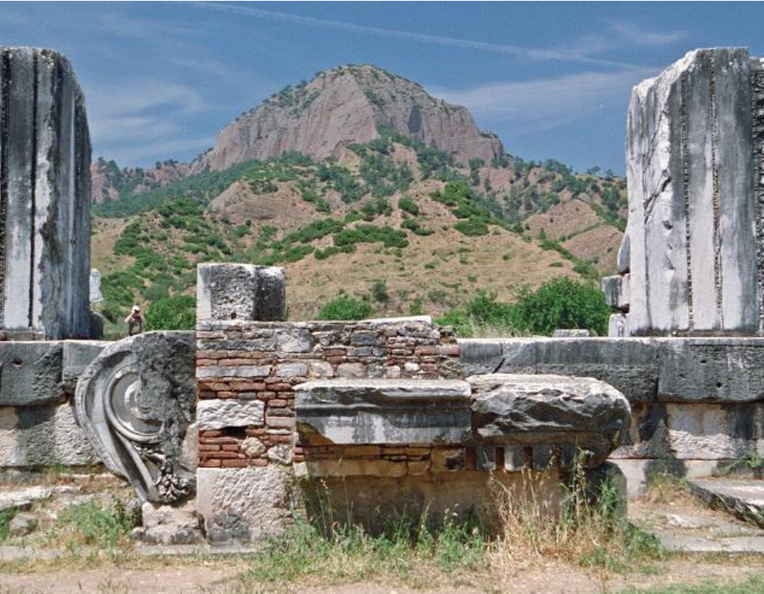
The Church At Sardis…
Temple of Cybele / Artemis…
More ruins of that temple…
Notes:
It appears that the Christian church at Sardis was very similar to the state of the general population. Complacent. Overconfident. Taking life for granted. They thought that they were spiritually secure and did not bother to guard against the subtle attacks of the enemy. They lived on their reputation. Judaism and Christianity were tolerated here within the Roman system, so they obviously did not want to ‘rock the boat’, but kept their heads down. They ‘blended in’.

Slide 7
Revelation Chapter 3:1-6
To the angel of the church in Sardis write: These are the words of him who holds the seven spirits of God and the seven stars.
I know your deeds; you have a reputation of being alive, but you are dead.
² Wake up! Strengthen what remains and is about to die, for I have found your deeds unfinished in the sight of my God.
Notes:
We already know that the seven stars represent all those angels of all those churches – the heavenly bride. Jesus, the future Bridegroom, holds these stars, His Heavenly Bride, firmly and securely. The term: “Seven Spirits of God” or “Sevenfold Spirit of God” (Seven = ‘Completeness’) represents the all-seeing Holy Spirit. Nothing can be hidden from Jesus – He knows! But the Holy Spirit is also a source of great power for those awake enough to walk with Him. It also speaks of Jesus, the Lamb of God having “seven eyes” (5:6), representing the Holy Spirit.
He knows their deeds. He also knows the motivation behind those deeds. Deeds just for show? Deeds to impress, when others are watching? Deeds to enhance the church’s reputation? The church members were very much like the citizens of Sardis – easy living and complacent; good when looked at from afar. From outward appearances it was probably a busy church, with lots going on; meetings and ministries, plenty of social media postings! Every baptism was publicised far and wide! “Look at us and what we’re doing for God!” – the church seemed to say.
But Jesus can see under the skin. “You are dead”. No struggling against persecution or hardship – because there wasn’t any. No opposition, because there was nothing to oppose. “Dead” means that Satan is not under threat, so he doesn’t need to fight back. “Dead” means a perfect model of inoffensive Christianity. “Dead” means socially accepted and spiritually atrophied. The ‘peace’ of the graveyard! A deep spiritual coma!
Jesus himself had the very opposite reputation. We read in Chapter 1v18 “I am the Living One; I was dead, and now look, I am alive for ever and ever!”
The only solution is to “WAKE UP!”
John 11:11. After he had said this, he went on to tell them, "Our friend Lazarus has fallen asleep; but I am going there to wake him up.“ (Lazarus was dead!).
Ephesians 5:14 NIV. “Wake up, sleeper, rise from the dead, and Christ will shine on you.”
Isaiah 52:1-2 NIV. “Awake, awake, Zion, clothe yourself with strength! Put on your garments of splendour, Jerusalem, the holy city. The uncircumcised and defiled will not enter you again.
The situation is urgent: the enemy is creeping up on them and soon they will cease to exist! They badly need Christ to strengthen them. The light is going out because they have almost run out of oil. But the situation is not completely hopeless. Jesus can wake the dead – if they are listening!
Unfinished deeds are worthless. A waste of time. A vine without fruit is pointless. Complacency is will be the death of you!

Slide 8
Revelation Chapter 3:1-6
Remember, therefore, what you have received and heard; hold it fast, and repent.
But if you do not wake up, I will come like a thief, and you will not know at what time I will come to you.
Notes:
God breathes urgency into his people. What have they received and heard? The gospel of grace. REMEMBER! Rebuild your love of the gospel and the scriptures. Restore your relationship with the words and the ways of the Son of God. REPENT! Change your ways of thinking about Jesus and His Kingdom. All that teaching and prophetic input that you have received in the past – do something about it! In your mind, climb back onto the battlements and defend your city! There is still time! Watch, pray, and obey. Don’t stay asleep in the light!
Church of Sardis: this is your final warning. If you refuse to wake up, Jesus himself will arrive and surprise you. Judgement often begins with the Household of God!
Revelation 16:15 NIV. "Look, I come like a thief! Blessed is the one who stays awake and remains clothed, so as not to go naked and be shamefully exposed.". Not the Second Coming, cos this was conditional. A visit from Jesus to judge his people.

Slide 9
Revelation Chapter 3:1-6
⁴ Yet you have a few people in Sardis who have not soiled their clothes. They will walk with me, dressed in white, for they are worthy. ⁵ The one who is victorious will, like them, be dressed in white.
Notes:
Yet you still have a few 'names' in Sardis (known to God), people who have not soiled their garments; they will walk with me in white. A faithful remnant! In Pergamum and Thyatira there were a few bad believers amongst the good; here in Sardis there are a few good amongst the bad!
Their unsoiled garments symbolize consistent obedience and courageous faith. Christ promises them the conqueror’s reward: communion with himself (walk with me) and the white clothing of victory.
In ancient temples, worshipers dared not approach deities with soiled clothes; the normal apparel in temples was white or linen.
Nakedness = sin; white clothing = righteousness and holiness
Just like Enoch (Genesis 5:24), they walked with Jesus, clothed in white. In Roman culture, white was also the colour of triumph. If we avoid compromise and complacency, we will be victorious and will enjoy an intimate walk with Jesus.

Slide 10
Revelation Chapter 3:1-6
I will never blot out the name of that person from the book of life, but will acknowledge that name before my Father and his angels.
⁷ Whoever has ears, let them hear what the Spirit says to the churches.
Notes:
Their name is secure in his book of life (20:15), and he will confess their name before the Father, since they have confessed Jesus in hostile circumstances (Matt. 10:32).
Cities in Asia Minor had citizen-registers; in an earlier period, Sardis was known for its royal archives. In many cities, names of criminal or dead citizens were deleted from the register immediately prior to their execution. Blotted out!
We have heavenly citizenship that we cannot lose if our faith is genuine:
John 6:37,39-40,44 NIV. “All those the Father gives me will come to me, and whoever comes to me I will never drive away. ³⁹ And this is the will of him who sent me, that I shall lose none of all those he has given me, but raise them up at the last day. ⁴⁰ For my Father's will is that everyone who looks to the Son and believes in him shall have eternal life, and I will raise them up at the last day. ⁴⁴ No one can come to me unless the Father who sent me draws them, and I will raise them up at the last day”.
Of course, many claim to have genuine faith, but their deeds demonstrate that it is counterfeit.
Matthew 8:32 Whoever acknowledges me before others, I will acknowledge before my Father in heaven. Whoever disowns me before others, I will disown before my Father in heaven.
Luke 12:8-9 I tell you, whoever publicly acknowledges me before others, the Son of Man will also acknowledge before the angels of God. 9 But whoever disowns me before others will be disowned before the angels of God.
There is always hope for a dead church, because Jesus specialises in raising the dead. "Let him hear what the Spirit says to the churches". Someone speaking to you can wake you up even if you are in a deep sleep.

Slide 11
How Does It All Apply to Us in TCF Today?
Are we complacent and asleep in the light?
Do we put our trust in wealth and our comfort-zone?
Do we try to ‘blend in’ and not ‘rock the boat’?
Does our reputation exceed our fruitfulness?
Do we have unfinished deeds, unclaimed promises, unheeded commands?
Are we watchful in prayer and walking with the Lord?
Are we confessing Jesus and sure of our eternal security?

Slide 12

Notes:
If Keith Green had been alive in around 90AD, this is the song he would have written for the church at Sardis.

